Slide 1


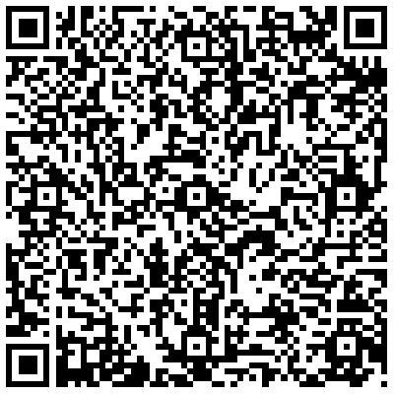
Mohamed ELshafei

Slide 2


Course Outline
Our Rules
Course Evaluation

Slide 3
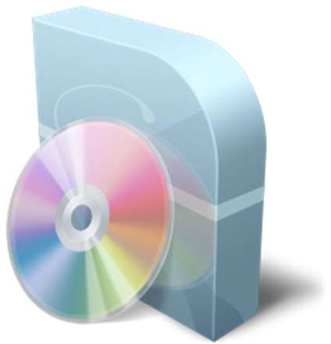

Computer Programs
Documentation

Slide 4



User Documentation
Technical Documentation
Marketing Documentation

Slide 5
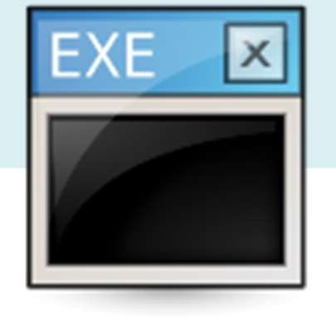



Generic
Customized

Slide 6



Stand- Alone
Interactive transaction-based
Embedded Control Systems
Entertainment Systems
Systems for modeling and simulation
Data Collection Systems
System of systems

Slide 7



Stand-alone applications
These are application systems that run on a local computer, such as a PC. They include all necessary functionality and do not need to be connected to a network.
Interactive transaction-based applications
Applications that execute on a remote computer and are accessed by users from their own PCs or terminals. These include web applications such as e-commerce applications.
Embedded control systems
These are software control systems that control and manage hardware devices. Numerically, there are probably more embedded systems than any other type of system.

Slide 8

Entertainment systems
These are systems that are primarily for personal use, and which are intended to entertain the user.
Systems for modeling and simulation
These are systems that are developed by scientists and engineers to model physical processes or situations, which include many, separate, interacting objects.

Slide 9

Data collection systems
These are systems that collect data from their environment using a set of sensors and send that data to other systems for processing.
Systems of systems
These are systems that are composed of a number of other software systems.

Slide 10


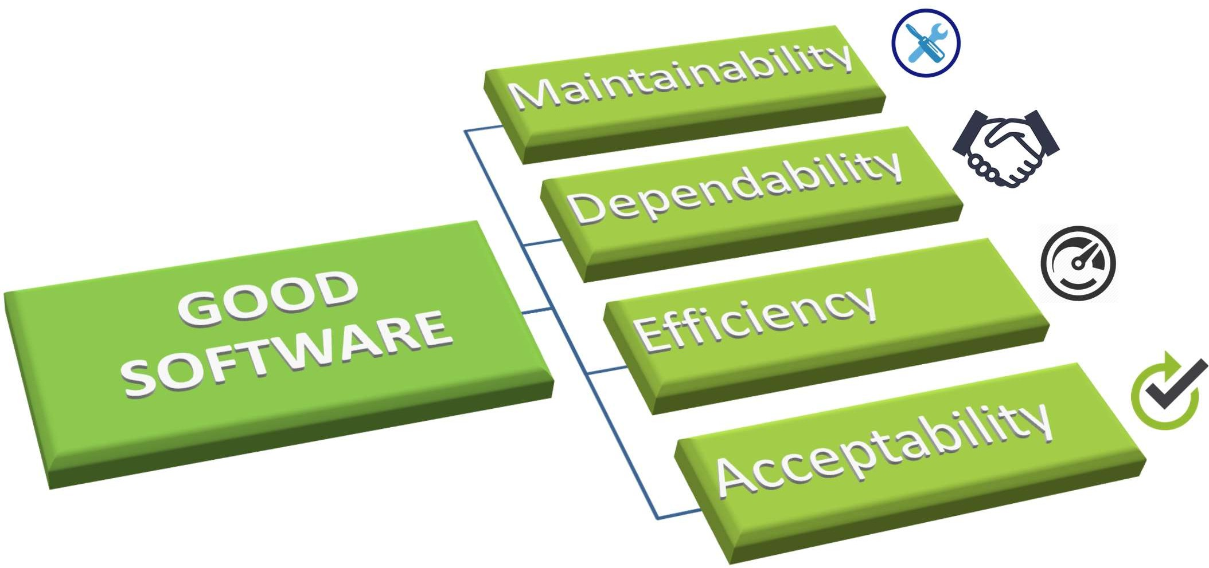

Slide 11


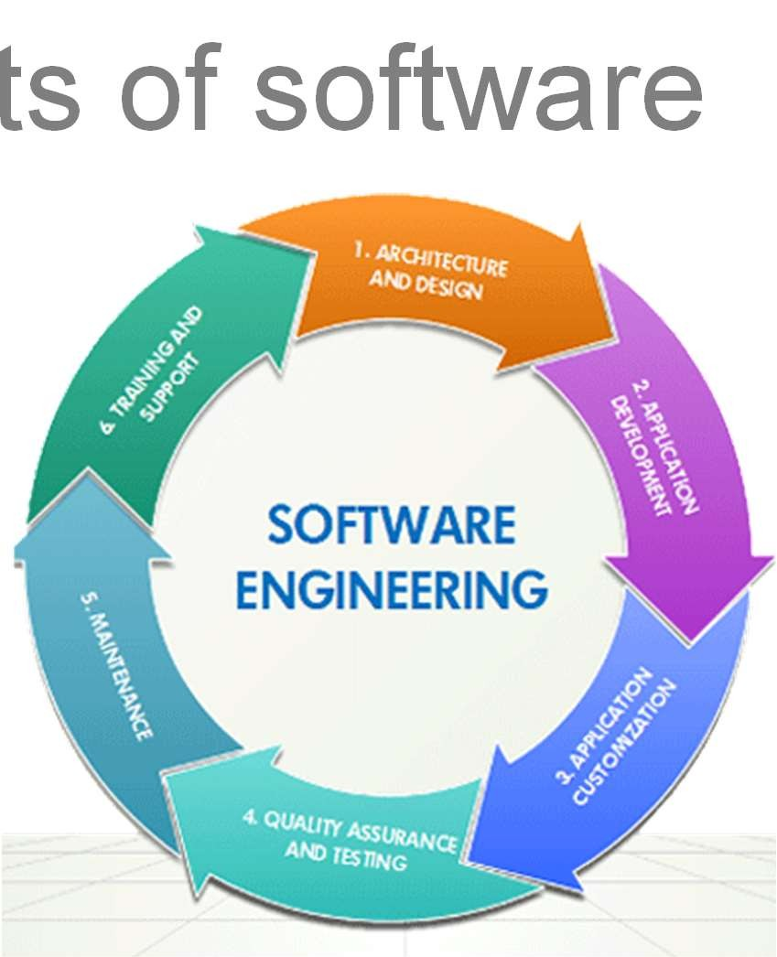
Software engineering:
is an engineering discipline that is concerned with all aspects of software production.

Slide 12

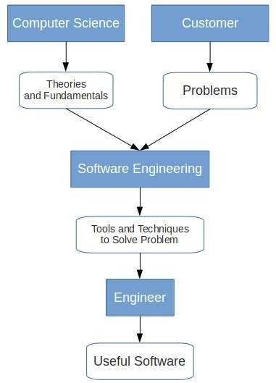
Computer science focuses on theory and fundamentals.
Software engineering is concerned with the practicalities of developing and delivering useful software.

Slide 13
A software process (also knows as software methodology) is a set of related activities that leads to the production of the software. These activities may involve the development of the software from the scratch or modifying an existing system.

Slide 14
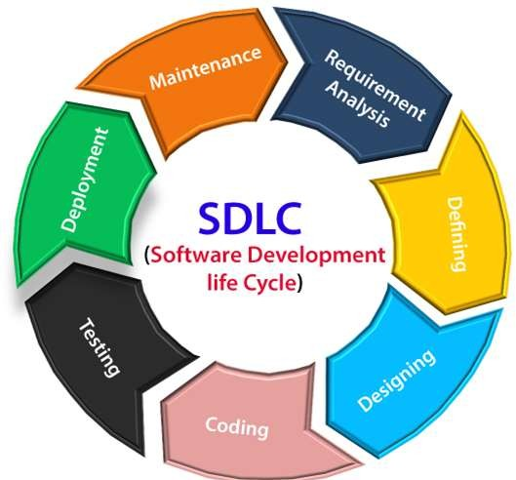

Slide 15

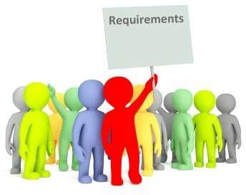
Descriptions of what the system should do the services that it provides and the constraints on its operation.
These requirements reflect the needs of customers for a system that serves a certain purpose

Slide 16
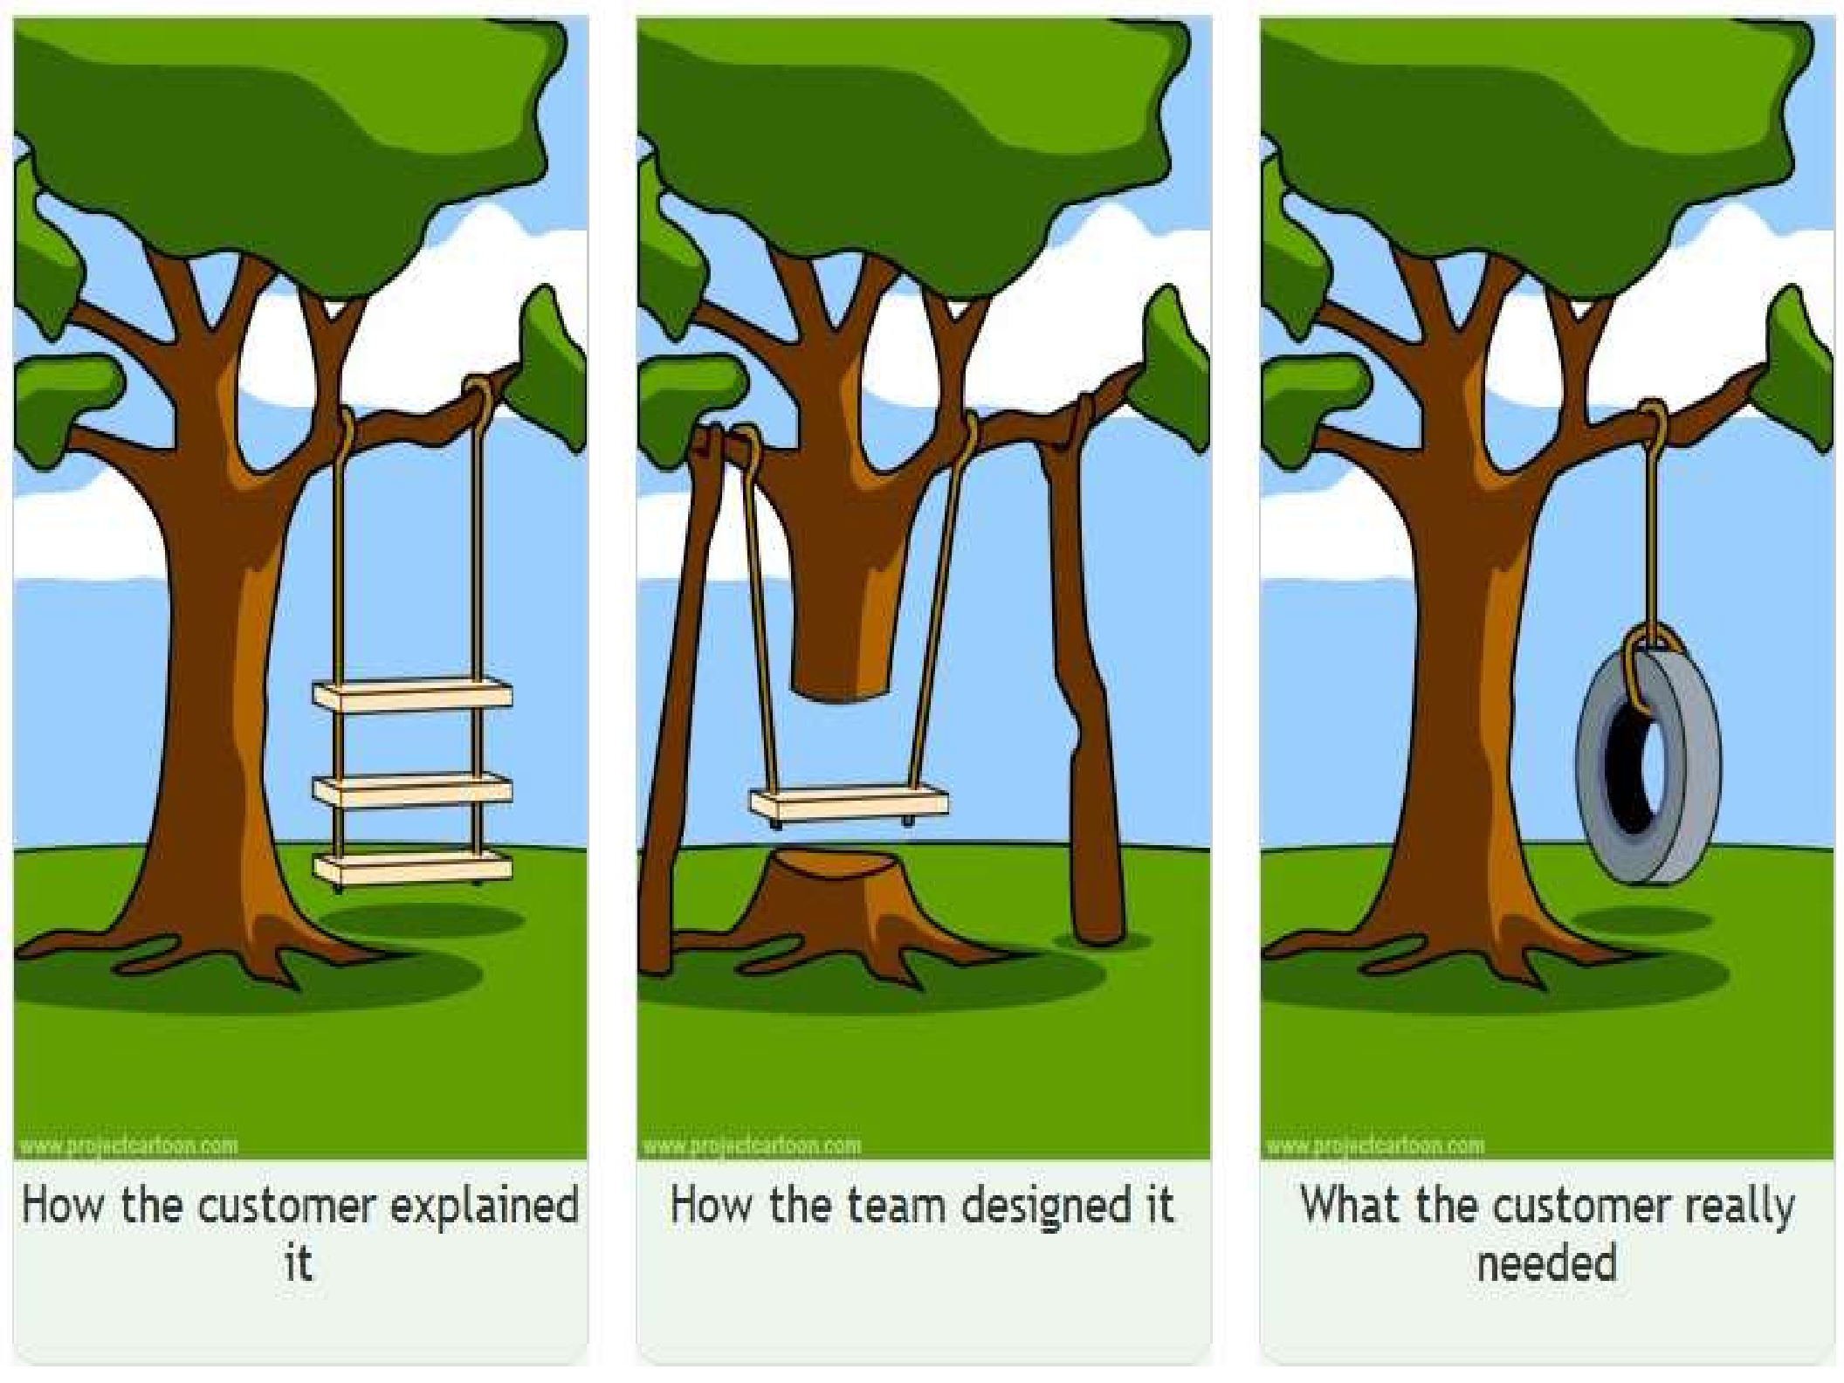

Slide 17
User requirements : are statements, in a natural language, of what services the system is expected to provide to system users.
“The System shall generate monthly management reports showing the Profit for each product prescribed by each Branch during that month.”

Slide 18
System requirements : are more detailed descriptions of the software system’s functions, services, and operational constraints.
should define exactly what is to be implemented.
It may be part of the contract between the system buyer and the software developers.

Slide 19
1. On the last working day of each month, a summary of the products
, their profit , and the branch shall be generated.
2. The system shall automatically generate the report for printing after
17.30 on the last working day of the month.
A report shall be created for each branch and shall list the individual Product names, the total number of this product , the number of sold, and the total Profit of this product .
If Product are available in Different sizes(e.g., 10 mg, 20 mg) separate reports shall be created for each Size unit.
Access to all profit reports shall be restricted to authorized users listed on a management access control list.”

Slide 20
Sometimes called the software requirements specification or SRS
Is an official statement of what the system developers should implement.
It should include both the user requirements for a system and a detailed specification of the system requirements.

Slide 21

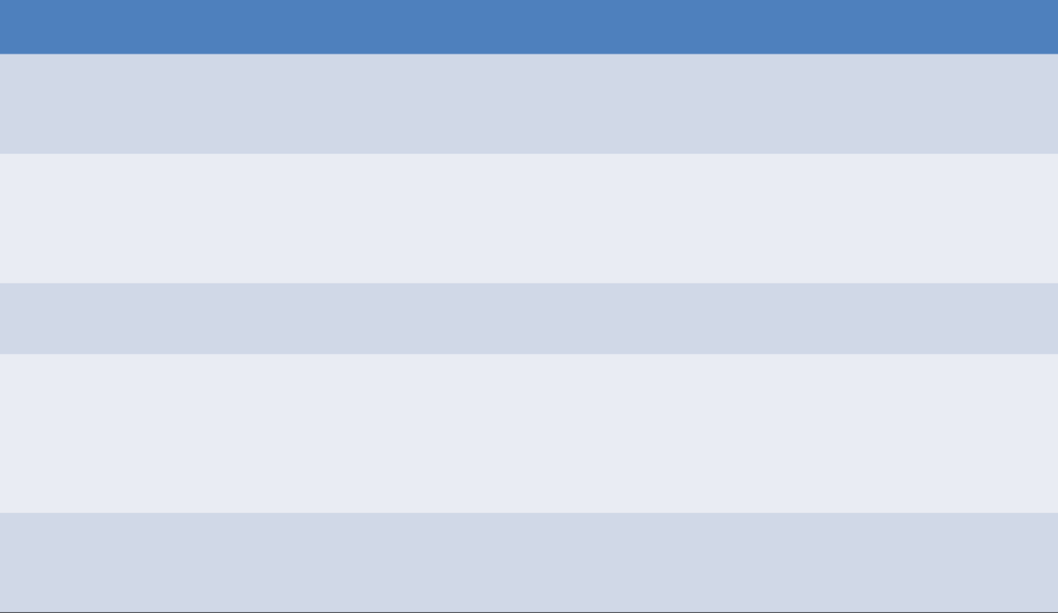
Chapter | Description
Preface | This should define the expected readership of the document and describe its version history, including a rationale for the creation of a new version and a summary of the changes made in each version.
Introduction | This should describe the need for the system. It should briefly describe the system’s functions and explain how it will work with other systems. It should also describe how the system fits into the overall business or strategic objectives of the organization commissioning the software.
Glossary | This should define the technical terms used in the document. You should not make assumptions about the experience or expertise of the reader.
User requirements definition | Here, you describe the services provided for the user. The nonfunctional system requirements should also be described in this section. This description may use natural language, diagrams, or other notations that are understandable to customers. Product and process standards that must be followed should be specified.
System architecture | This chapter should present a high-level overview of the anticipated system architecture, showing the distribution of functions across system modules. Architectural components that are reused should be highlighted.

Slide 22
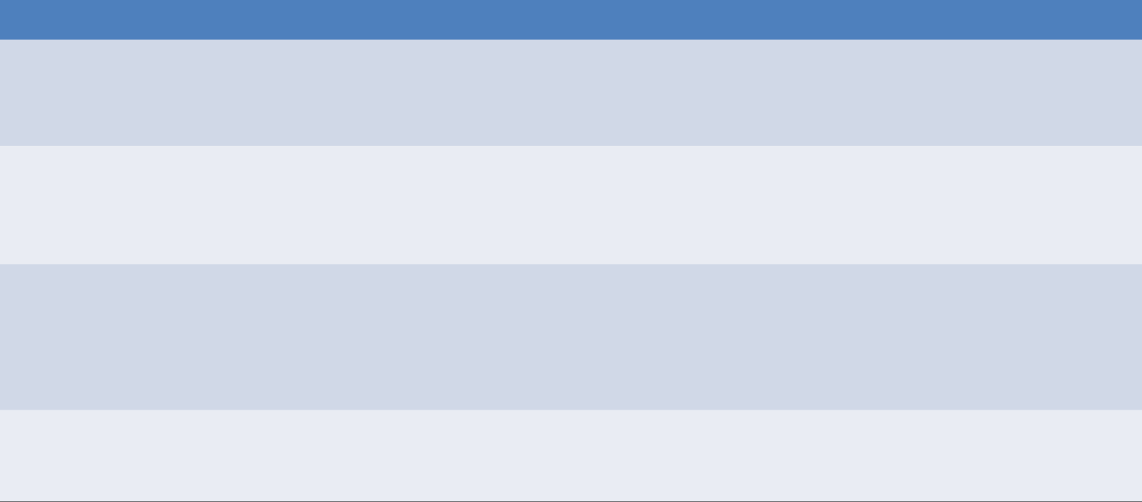
Chapter
System requirements specification
Description
This should describe the functional and nonfunctional requirements in more detail. If necessary, further detail may also be added to the nonfunctional requirements. Interfaces to other systems may be defined.
System models
This might include graphical system models showing the relationships between the system components and the system and its environment. Examples of possible models are object models, data-flow models, or semantic data models.
System evolution
This should describe the fundamental assumptions on which the system is based, and any anticipated changes due to hardware evolution, changing user needs, and so on. This section is useful for system designers as it may help them avoid design decisions that would constrain likely future changes to the system.
Index
Several indexes to the document may be included. As well as a normal alphabetic index, there may be an index of diagrams, an index of functions, and so on.

Slide 23
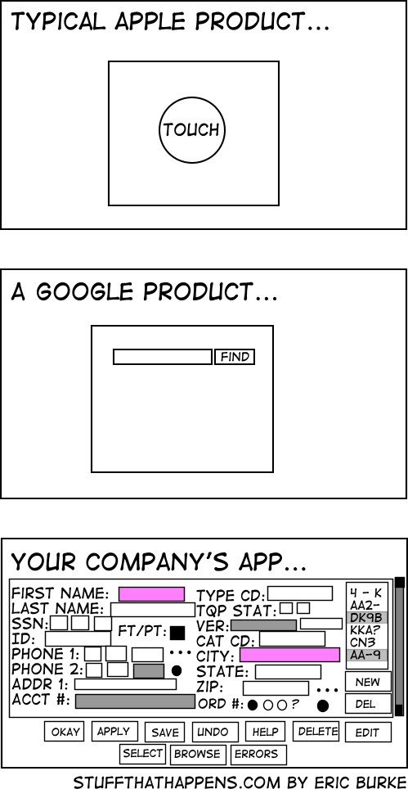
2. Design
Planning the software solution

Slide 24

Software design is an iterative process through which requirements are translated into a blueprint for constructing the software.
Initially, the blueprint depicts a holistic view of software.
During the design process the software specifications are transformed into design models .
Models describe the details of the data structures, system architecture, interface, and components.

Slide 25

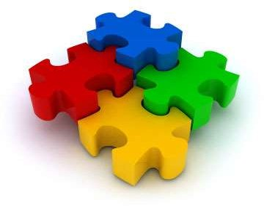
In this concept, software is divided into separately named and addressable components called modules
Follows “divide and conquer” concept, a complex problem is broken down into several manageable pieces
Easier to change
Easier to build
Easier to maintain

Slide 26

UI is the user interface. This comprises everything a user can see and touch, such as menu options, buttons, text, layouts, navigation elements, sharing options, etc
UX is why you made that change to affect how the user feels and behaves. The user experience is an umbrella term for the user’s overall experience with the product: what they liked about it and how easily they accomplished their goals

Slide 27
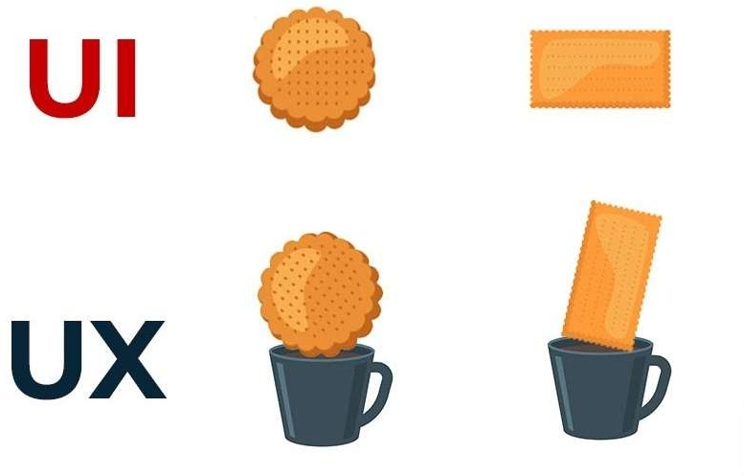

Slide 28
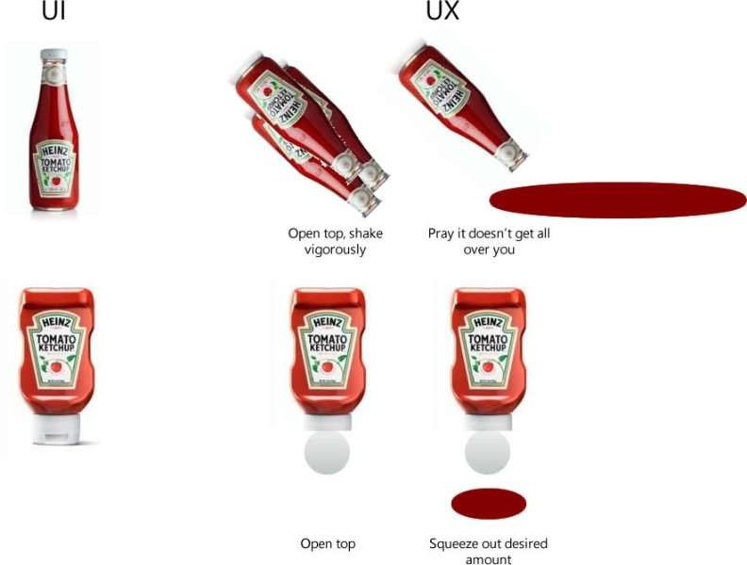

Slide 29
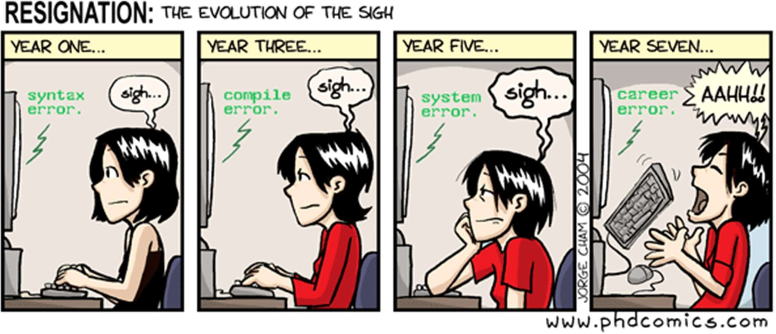
3. Implementation
Code!!!

Slide 30
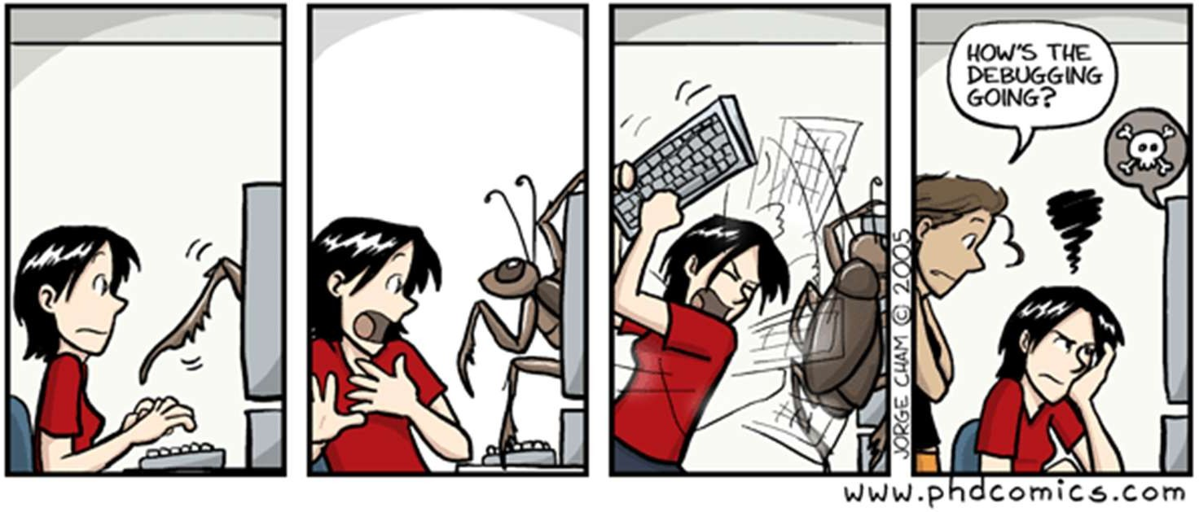
4. Testing
Executing the application trying to find software bugs

Slide 31
Verification:
"Are we building the product right”.
The software should conform to its specification.
Validation:
"Are we building the right product”.
The software should do what the user really requires.

Slide 32


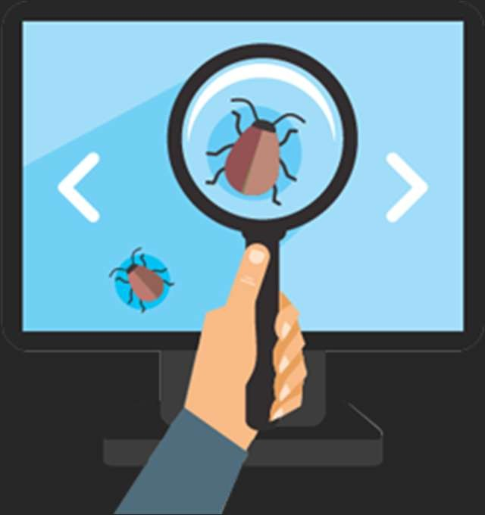

Slide 33


Testing is intended to show that a program does what it is intended to do and to discover program defects before it is put into use.
When you test software, you execute a program using artificial data.
Testing is part of a more general verification and validation process, which also includes static validation techniques

Slide 34

Software Testing is important as it may cause mission failure, impact on operational performance and reliability if not done properly.
Effective products
software satisfying
testing delivers quality software user’s
requirements, needs and
expectations.

Slide 35
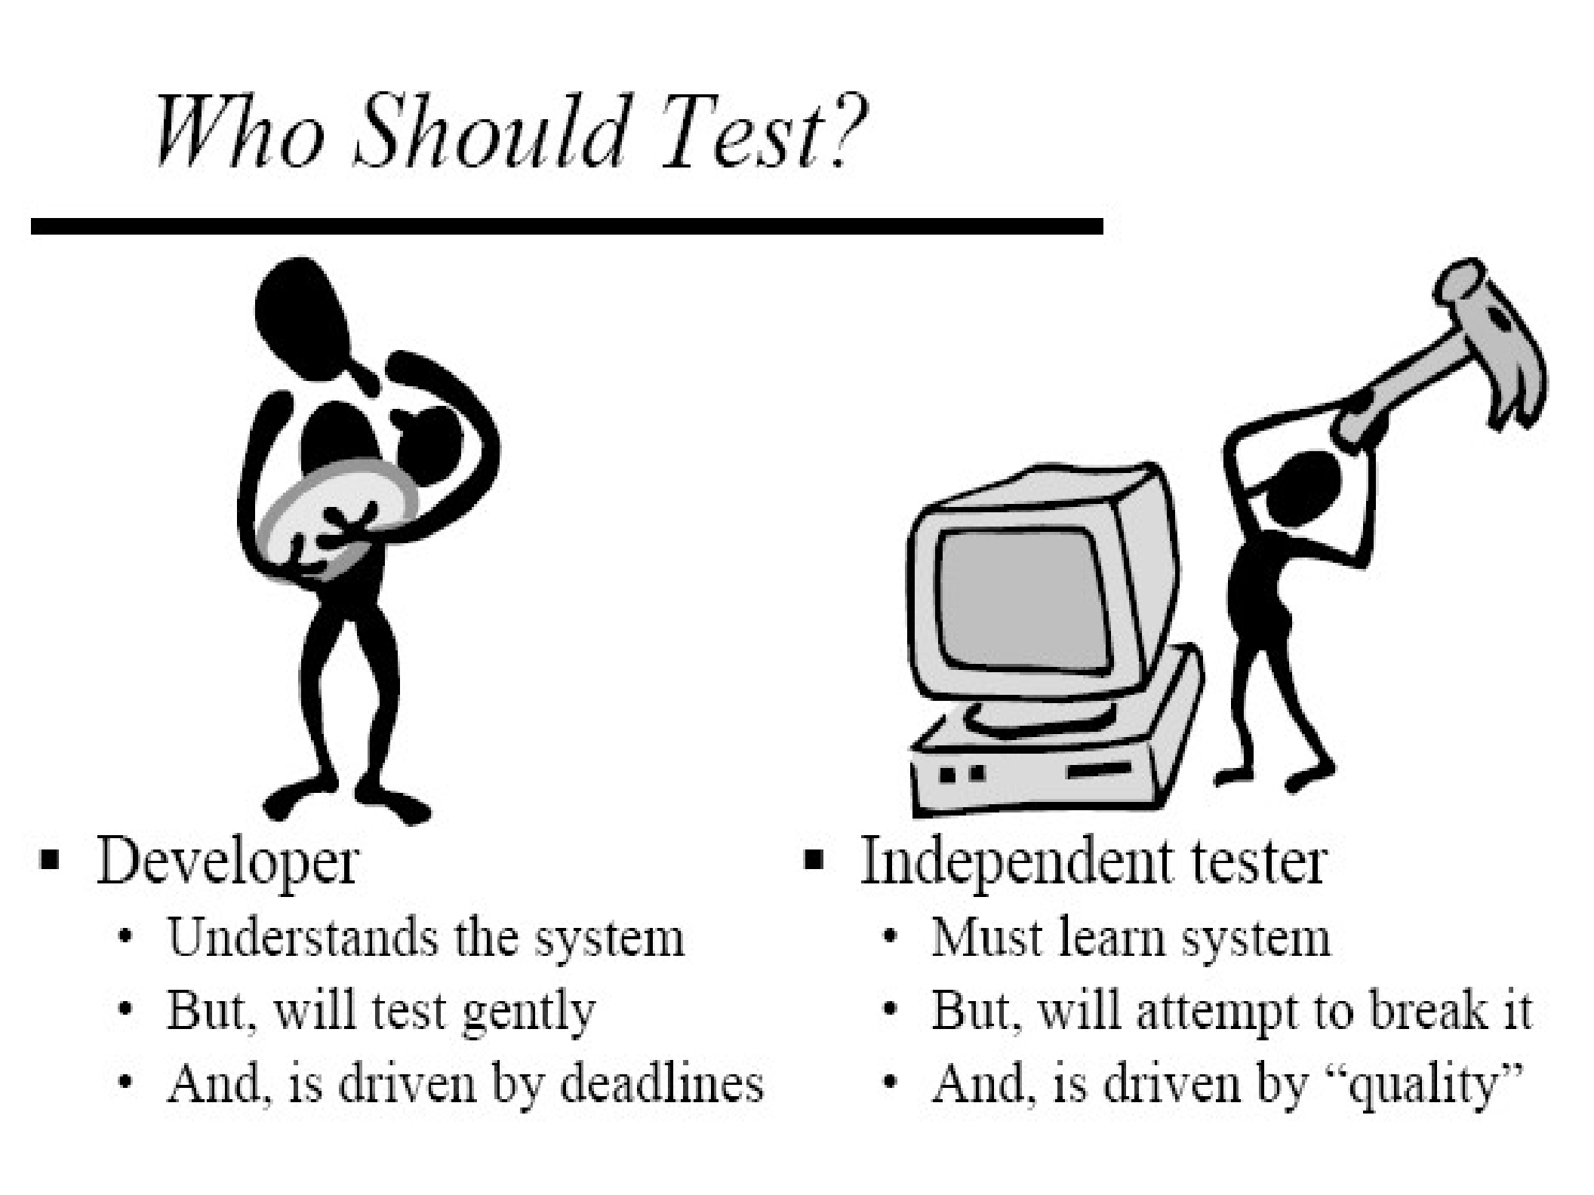

Slide 36





&

Slide 37
Error: An error is a human action that produces the incorrect result that results in a fault.
Bug: An Error found in the development environment before the product is shipped to the customer.
Defect : is the difference between expected and actual result in the context of testing.
Fault: A wrong or mistaken step, process or Data definition in a computed program which causes the program to perform in an unintended or unanticipated manner.
Failure: Deviation of the software from its expected result. It is an event.

Slide 38

A test case is a document, which has a set of test data, preconditions, expected results and post conditions, developed for a particular test scenario in order to verify compliance against a specific requirement.
The process of developing test cases can also help find problems in the requirements or design of an application.

Slide 39

Development testing, where the system is tested during development to discover bugs and defects.
Release testing, where a separate testing team test a complete version of the system before it is released to users.
User testing, where users or potential users of a system test the system in their own environment.

Slide 40
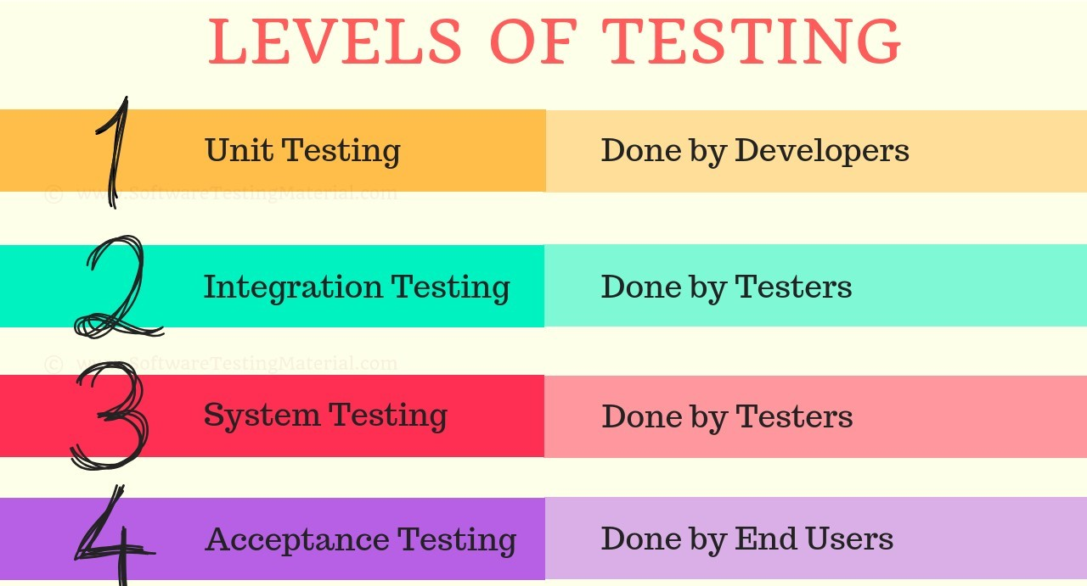

Slide 41
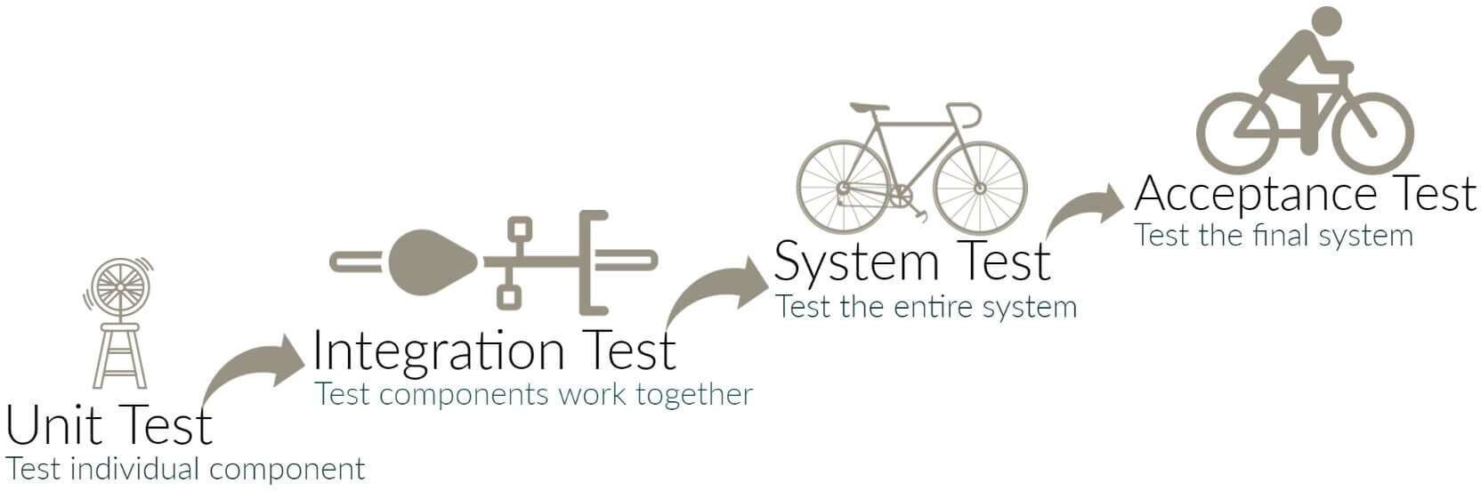

Slide 42
Unit testing is done to check whether the individual modules of the source code are working properly. testing each and every unit of the application separately by the developer in the developer’s environment.
errors are detected individually from every component or unit by individually testing the components or units of software to ensure that if they are fit for use by the developers. It is the smallest testable part of the software.

Slide 43
Integration Testing is the process of testing the connectivity or data transfer between a couple of unit tested modules.
It is subdivided into the Top-Down Approach, Bottom-Up Approach and Sandwich Approach (Combination of Top Down and Bottom Up).
This process is carried out by using dummy programs called Stubs and Drivers. Stubs and Drivers do not implement the entire programming logic of the software module but just simulate data communication with the calling module

Slide 44
It’s a black box testing. Testing the fully integrated application this is also called as an end to end scenario testing.
To ensure that the software works in all intended target systems. Verify thorough testing of every input in the application to check for desired outputs. Testing of the users’ experiences with the application.

Slide 45
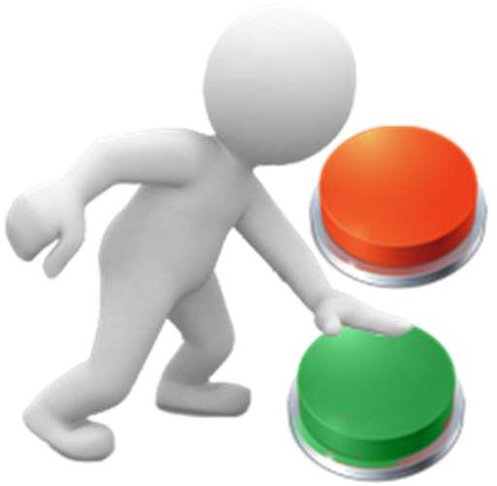
A formal test conducted to determine whether or not a system satisfies its acceptance criteria and to enable the customer to determine whether or not to accept the system.
It is the final test action before deploying the software. The goal of acceptance testing is to verify that the software is ready and can be used by the end user to perform the functions for which the software was built.

Slide 46

The application is tested by the users who doesn’t know about the application.
Done at developer’s site under controlled conditions
Under the supervision of the developers.

Slide 47

This Testing is done before the final release of the software to end-users.
Before the final release of the software is released to users for testing where there will be no controlled conditions and the user here is free enough to do what ever he wants to do on the system to find errors.

Slide 48
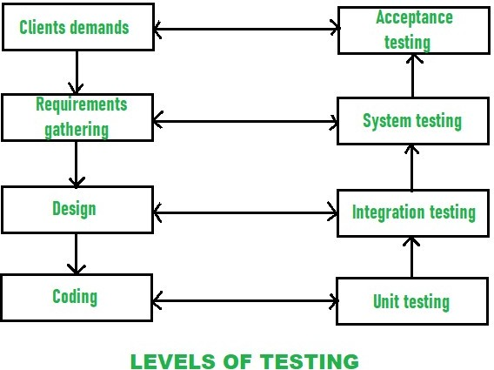

Slide 49
White Box Testing is a software testing method in which the internal structure/ design/ implementation of the item being tested is known to the tester.
Black Box Testing is a software testing method in which the internal structure/ design/ implementation of the item being tested is NOT known to the tester

Slide 50
Under Static Testing code is not executed. Rather it manually checks the code, requirement documents, and design documents to find errors.
Under Dynamic Testing code is executed. It checks for functional behavior of software system
, memory/cpu usage and overall performance of the system.

Slide 51
Bug Id
Test case Id Bug Description Bug Priority Identified by Module
Project Dated
: Sys_def_xyz_o1
: Sys_xyz_o1
: Specify the defect.
: Major or Minor
: ABC
: Database Operations
: XYZ Corporation
: 22/9/03

Slide 52

Quality is defined as meeting the customer’s requirements and according to the standards
The best measure of Quality is given by FURPS
Functionality
Usability
Reliability
Performance
Scalability

Slide 53
QA is a set of activities for ensuring quality in the processes by which products are developed.
QA aims to prevent defects with a focus on the process used to make the product. It is a proactive quality process.
The goal of QA is to improve development and test processes so that defects do not arise when the product is being developed.

Slide 54

QC is a set of activities for ensuring quality in products. The activities focus on identifying defects in the actual products produced.
QC aims to identify (and correct) defects in the finished product. Quality control, therefore, is a reactive process.
The goal of QC is to identify defects after a product is developed and before it's released.

Slide 55

Quality Assurance makes sure that we are doing the right things, the right Way.
Quality Control makes sure the results of what we’ve done are what we expected .
QA focuses on building in quality and hence preventing defects.
QC focuses on testing for quality and hence detecting defects.
QA deals with process.
QC deals with product.
QA is for entire life cycle.
QC is for testing part in SDLC.
QA is managerial process.
QC is corrective process.

Slide 56

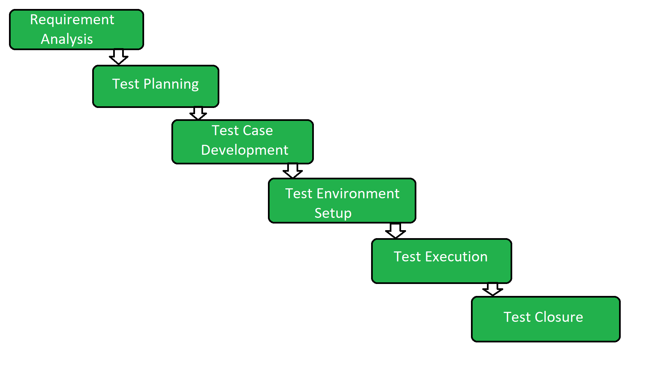

Slide 57


Slide 58


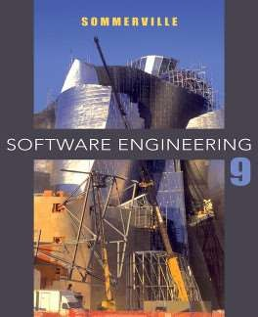
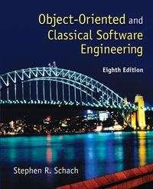
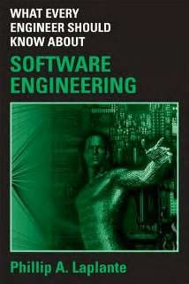

Slide 59


Success in Programming
SOFT SKILLS
The developer's life manual

